Slide 2
Manchester Central Site Induction

Slide 3
Aims of this induction:
Identifying key information and instruction necessary to work safely at Manchester Central, including:
Fire evacuation procedures
Permit to work procedure
Event build and breakdown procedures
Site rules
Environment and Sustainabilty policy

Slide 4
This induction is split into two areas:
Events & General
Building

Slide 5
Events & General

Slide 6
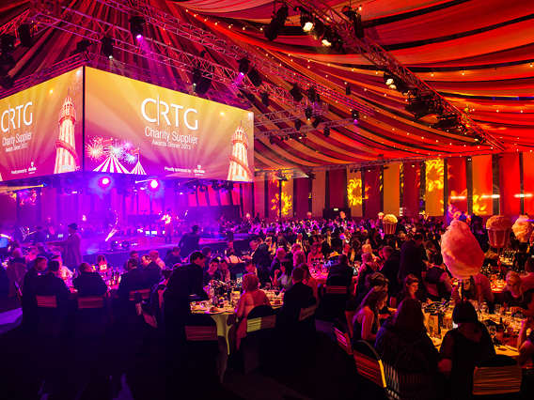

Slide 7
Events & General
Whilst working at Manchester Central, it is important that you’re aware of the safety rules, procedures and arrangements that are in place for your safety and that of your colleagues.
All of your employees or contractors are required to watch this presentation prior to working at, or around the venue, on an event.

Slide 8
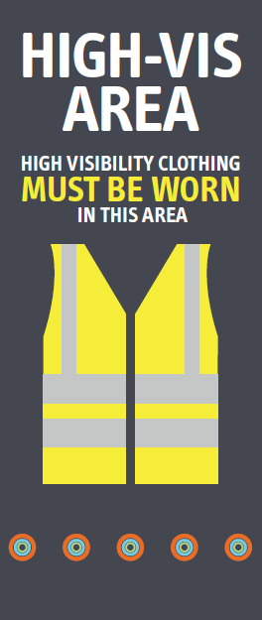
Build and Breakdowns
During all event builds and breakdowns at Manchester Central, ALL staff and contractors are required to wear hi vis clothing in order to access and work in the event space.

Slide 9
Hi vis vests are available to purchase from the venue, but we advise contractors to bring their own
Some event builds may require all contractors to wear safety footwear
Ensure all of your contractors or employees are aware of the venue rules including hi vis clothing PRIOR to working on site

Slide 10
Site Rules:
Wear your hi vis vests at all times during event builds and breakdowns
Appropriate footwear should be worn whilst working in the venue
Ladder work must only be conducted for short work periods
You must NOT stand on the top tier of your ladders - any unsafe ladder work may result in the employee being ejected from the venue
Any areas where Working at Height is being carried out, the immediate area must be controlled

Slide 11
During builds and breakdowns, you must ensure aisles are kept clear at all times
No persons are permitted to operate plant or machinery (including fork lift trucks) unless they have received adequate training
Any vehicle or plant driven within the hall must adhere to the 5MPH speed limit. This includes fork lift truck. Traffic movements may take place within the hall including fork lift trucks, plant and trucks. Drivers must be competent and adhere to the designated lanes where identified. Pedestrians always take priority within halls. Banksmen must be used when and where necessary. Hi Viz vests must be worn whilst traffic movements take place within the halls

Slide 12
Smoking (including e-cigarettes) is only permitted in the designated smoking areas
Any person suspected to be under the influence of drugs or alcohol will be ejected from the venue
Hard hats must be worn when necessary
No hot works can take place in the venue (including event space) without a Hot Works Permit being issued
Activities requiring a Hot Works Permit include, but are not limited to: Soldering, Angle Grinding & Welding
No substances are to be used in the hall which have not been pre agreed by the venue or event organiser

Slide 13
First Aid:
During builds and breakdowns a designated first aider will be present throughout. To contact first aid, you can either;
Contact a member of the traffic team or security, who will radio first aid
Call first aid on radio channel 6 if you have a venue radio
Contact security via internal telephone (dialling 2206)
Visit the first aid room located in-between Charter Foyer and Central Foyer
All accidents, incidents or near misses MUST be reported

Slide 14
When requesting first aid, you must state:
Who you are
Who the injured person is
What the issue or injury is
The location

Slide 15
Fire and Evacuation:
The building has a two stage fire alarm system
The first stage alerts venue staff of a potential fire, which will instigate an investigation. At this point, you will not know anything about the ongoing investigation
If a fire is identified during the investigation, or a secondary smoke detector is activated, the fire alarm will initiate the evacuation message. This message is a combination of a beacon and voice instruction
The voice instruction relays the following message:-

Slide 16
“Attention Please! Attention Please! Will Everybody Please Leave The Building by The Nearest Exit. This Is An Emergency. The Staff Will Assist And Direct You. Please Do Not Use The Lifts”

Slide 17
On hearing the alarm, all contractors, staff and visitors must make their way out of the venue by the nearest available exit
The venue has two assembly points;
- The Rear Car Park, and
- The Front Forecourt, Windmill Street
All persons are to evacuate to the closest assembly point

Slide 18
Fire assembly points
Front Forecourt
Rear Car Park

Slide 19
Building

Slide 20
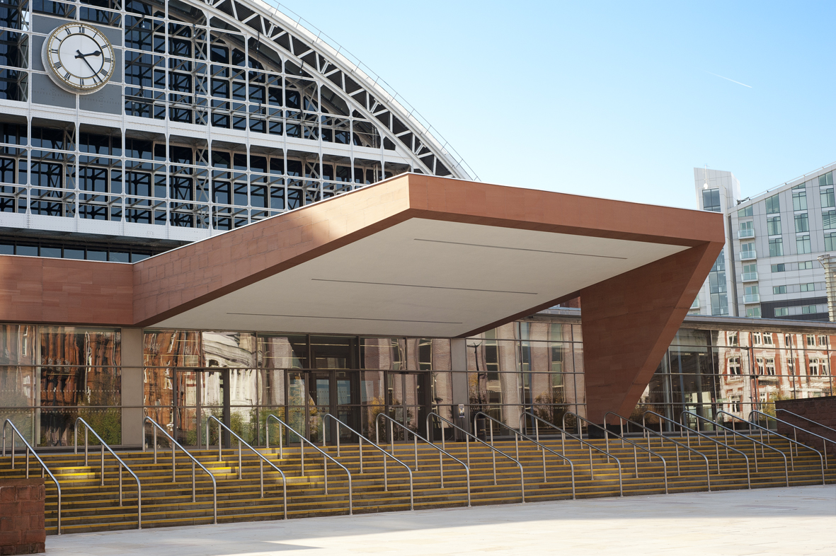

Slide 21
Site Rules
Activities requiring a permit cannot take place in the venue (including the event space) without the appropriate permit being issued. Activities requiring a permit include, but are not limited to:
Hot Works, Working at Height, Working in HV Switch rooms / Plant Areas; Working in Confined Spaces, Working within Areas Subject to Access Control.
Permits and access to the relevant areas are only provided by FM once associated paperwork has been submitted and reviewed

Slide 22
A number of toilet and wash facilities are provided throughout the building
If you have been provided with a fob / access card, it is important that you do not allow other people to ‘tailgate’ you when walking through different access controlled doors
If you have been issued with a radio, ensure that you know your radio channel allocation, and other department channels
Channel 1 – Security Channel 2 – Events Channel 4 – Hospitality
Channel 5 – FM Channel 6 – First Aid Channel 7 – Traffic
Channel 8 – Hs/keeping Channel 9 – Floor Services Channel 10 – Stewards
Channel 12 – GES Channel 11 – AV / IT Channel 16 - Emergency

Slide 23
Environment
Manchester Central are committed to responsible waste management and delivering sustainable events.
It is a requirement that all FM and Event contractors manage their waste responsibly, removing from site accordingly.
The venue has a recycling centre which is used to segregate and recycle all waste including wood, electrical equipment and metal from site.
All environmental incidents must be reported to Manchester Central via the site manager or supervisor

Slide 24
Contact
If you require further information, please contact your event organiser or contact venue safety on:
Email: HSE@manchestercentral.co.uk
Telephone: 0161 834 2700

